Slide 1
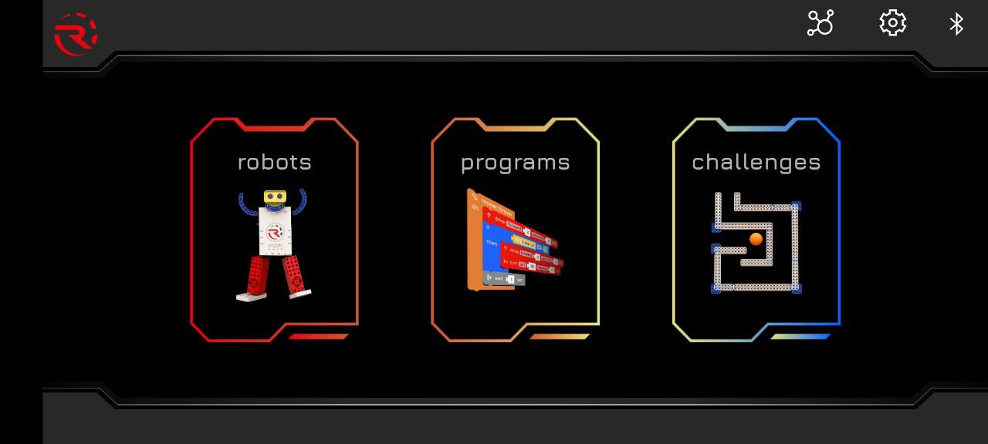

Slide 2
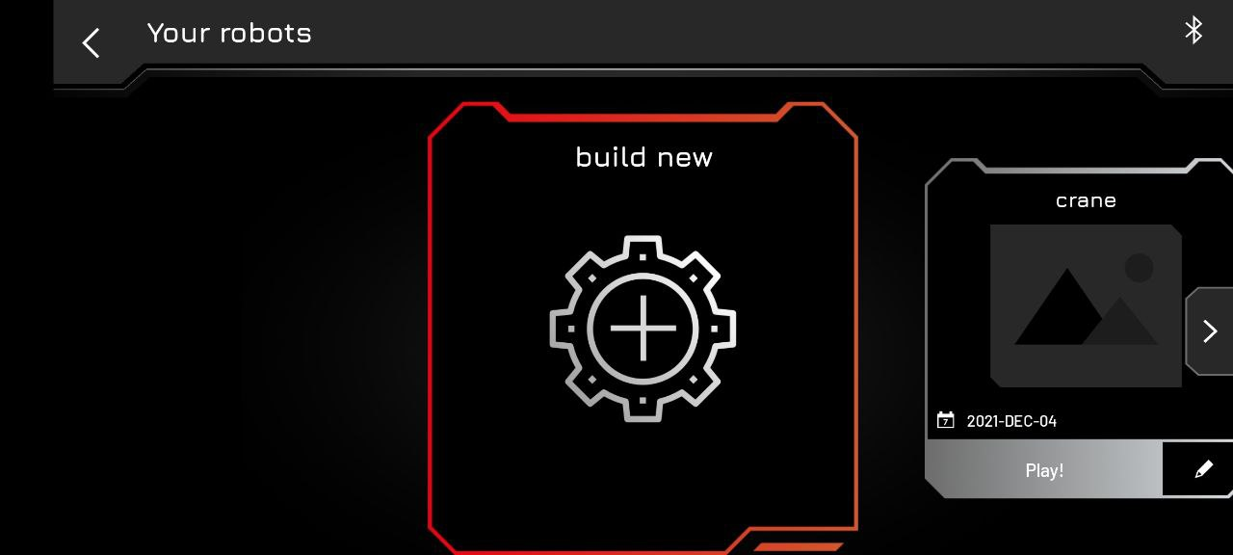

Slide 3
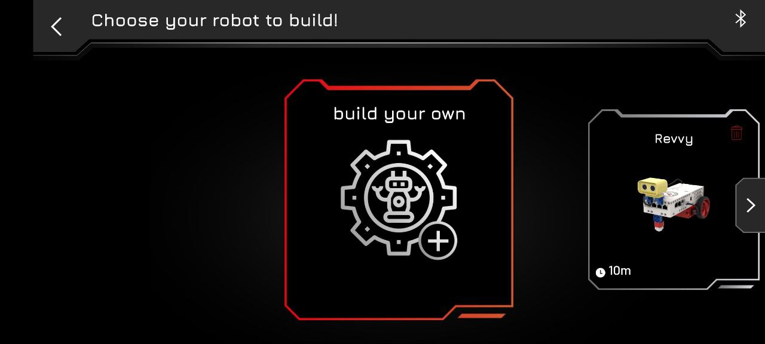

Slide 4
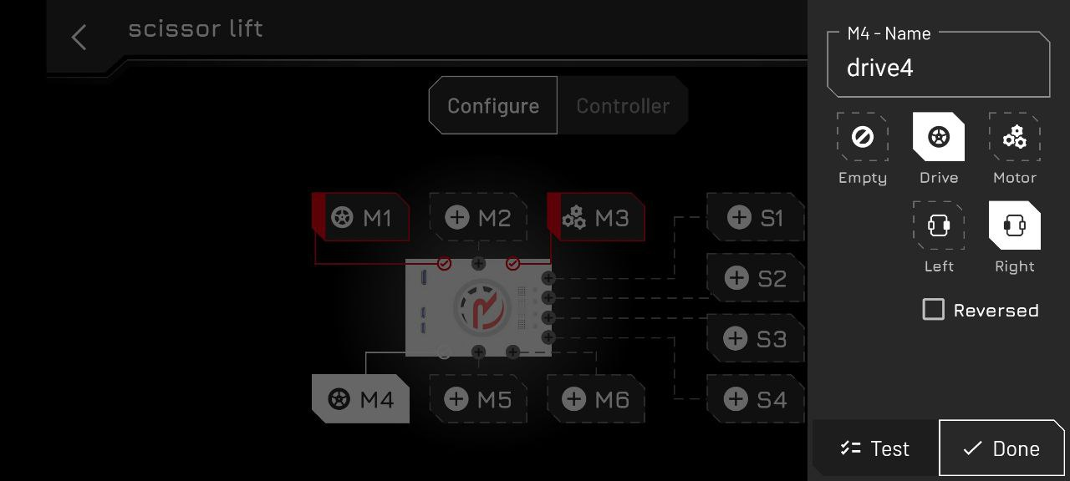
Motor is connected to the “M4” port will supply the movement of the robot and play right wheel role. That is why we should configure in this way.

Slide 5
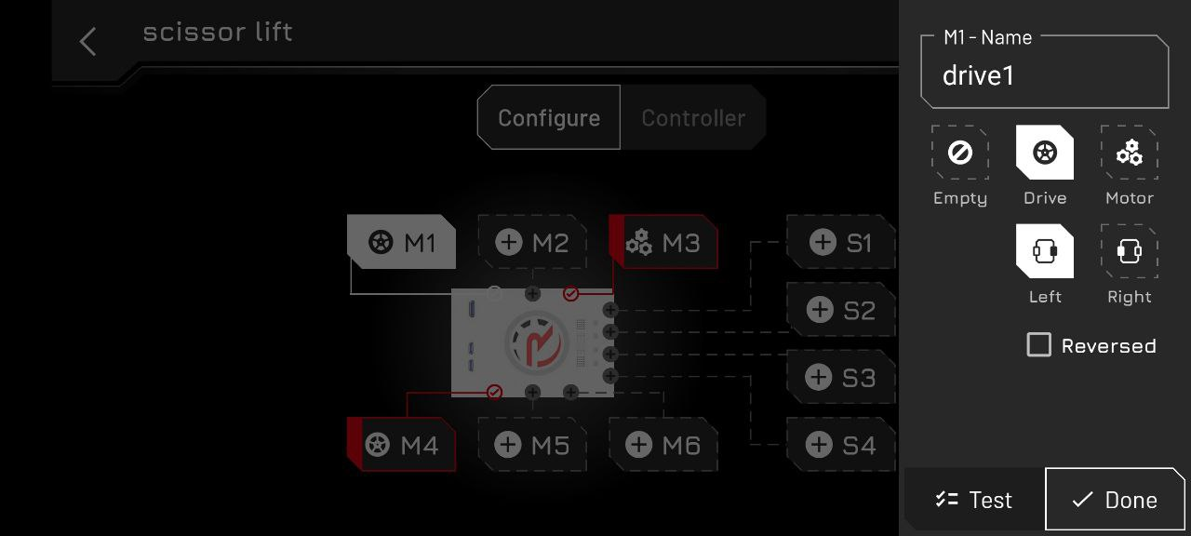
Motor is connected to the “M1” port will supply the movement of the robot and play left wheel role. That is why we should configure in this way.

Slide 6
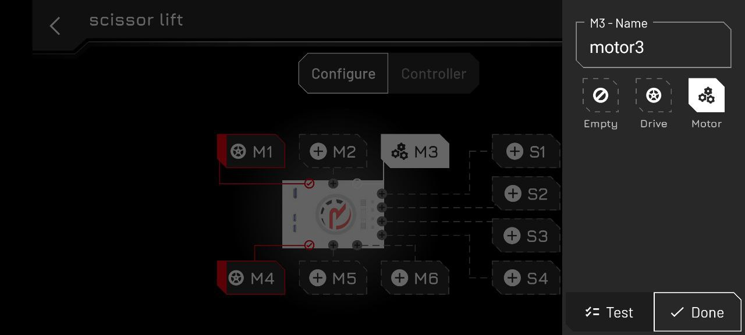
Motor is connected to the “M3” port will supply the power to scissor lift mechanism to rise or drop. That is why we should configure as motor, not like drive.

Slide 8
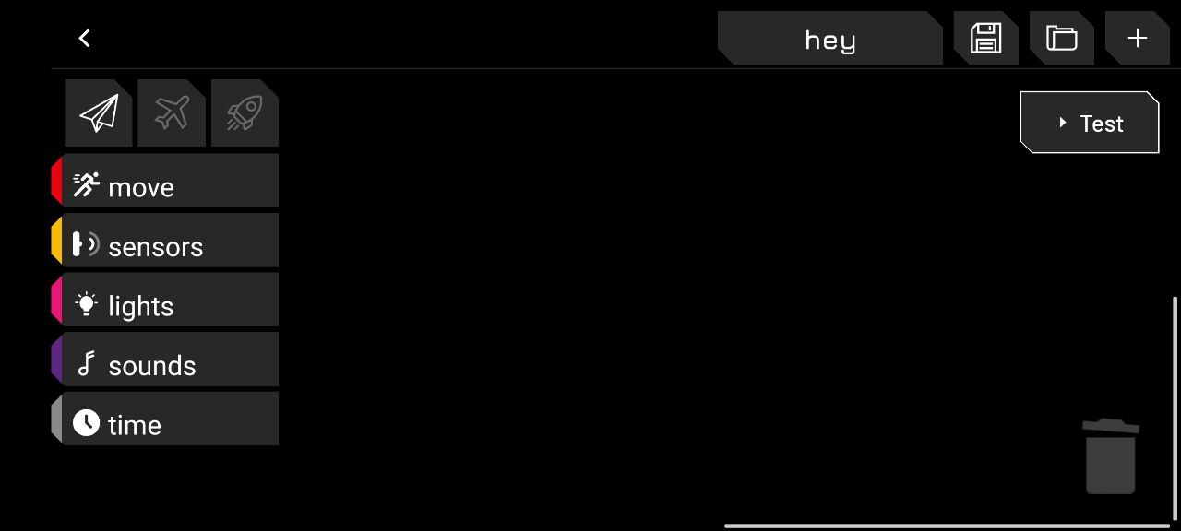
Previous Code is here
We should save it and crate new one

Slide 9
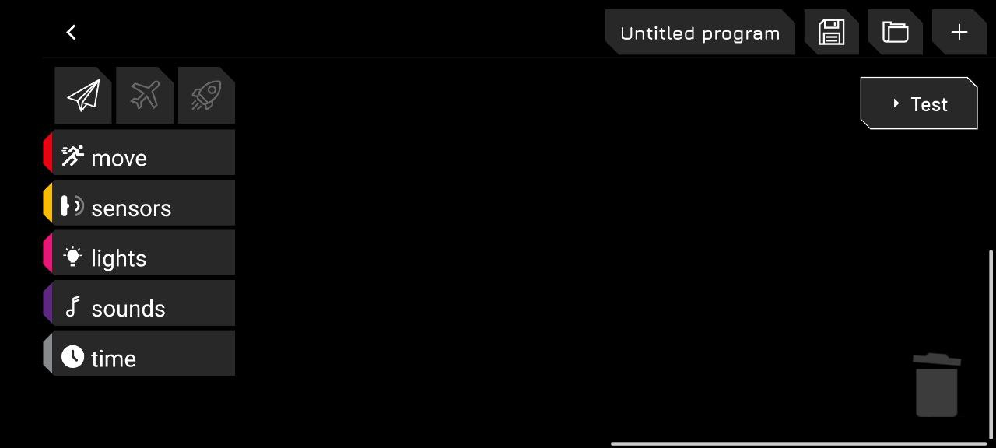
This is newly created one

Slide 10
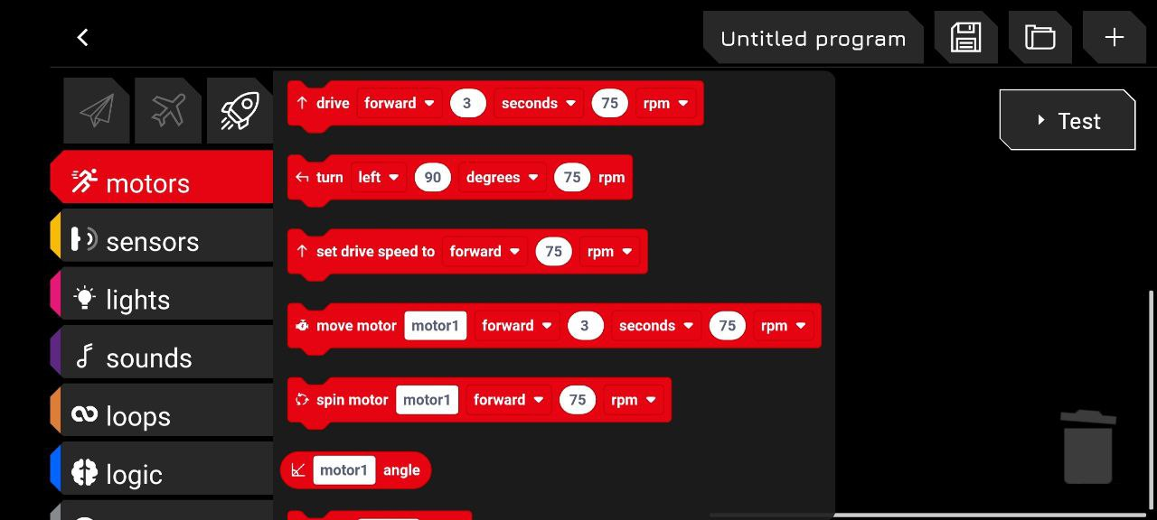
We will see different movement blocks
We will select “move motor”

Slide 11
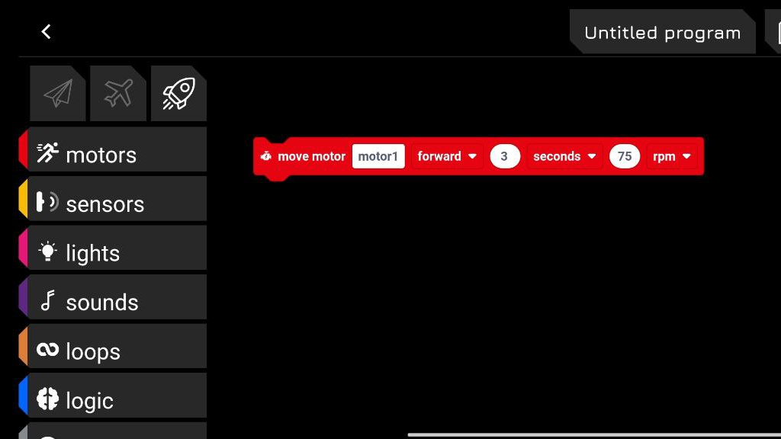
This is the default version of the motor block. We should change and customize it.

Slide 12

Our motor is in third port that why we are changing the “motor1” to “motor3”.

Slide 13
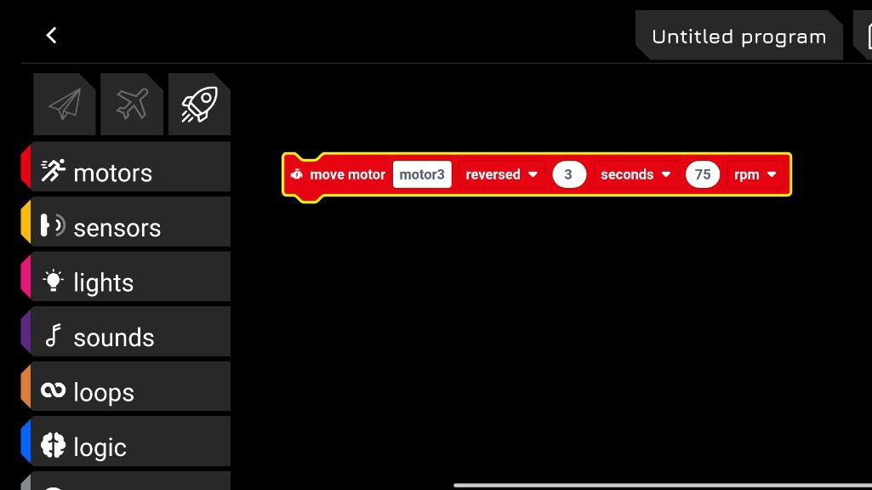
This section determine the rotating direction of the motor. In our case we should change it to “reversed”. In this case our mechanism will lif.

Slide 14
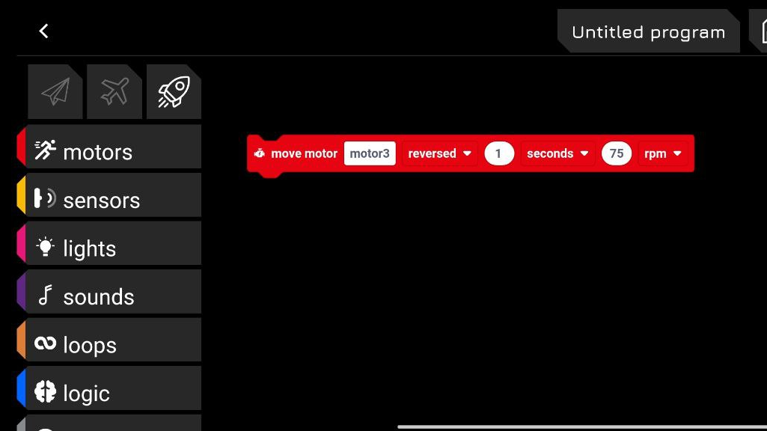
This part of the motor block we write the operation time of the motor. In the first case, “1” will be tested.

Slide 15

This section defines the speed of motor. It should be decreased to “34 rpm”. Higher speed can lead to unstable movement of the scissor mechanism.

Slide 16
Great! We can test our code at this moment.
After running the code, scissor mechanism should rise..

Slide 17
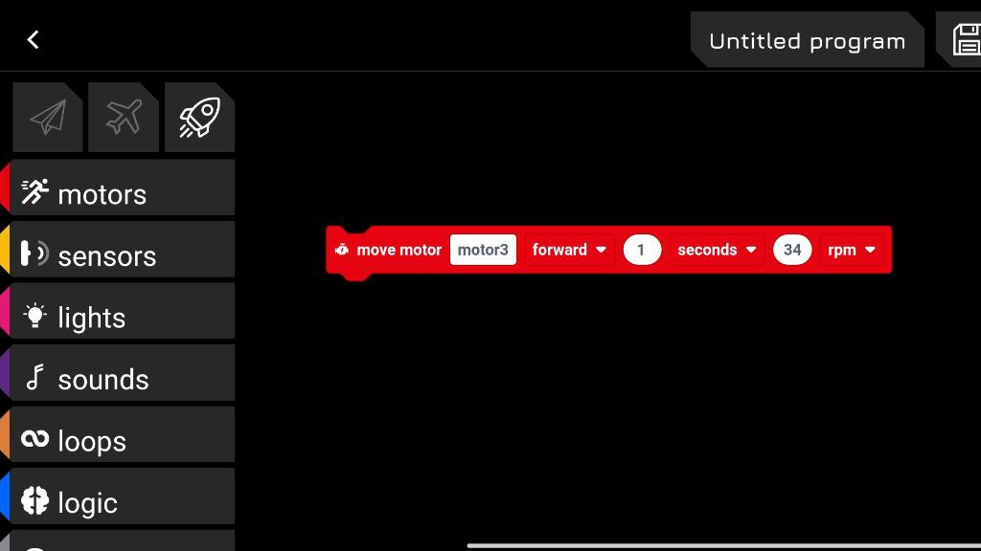
After rising the scissor mechanism, we should drop it. That is why the direction of the movement should be changed from “reversed” to “forward”

Slide 18
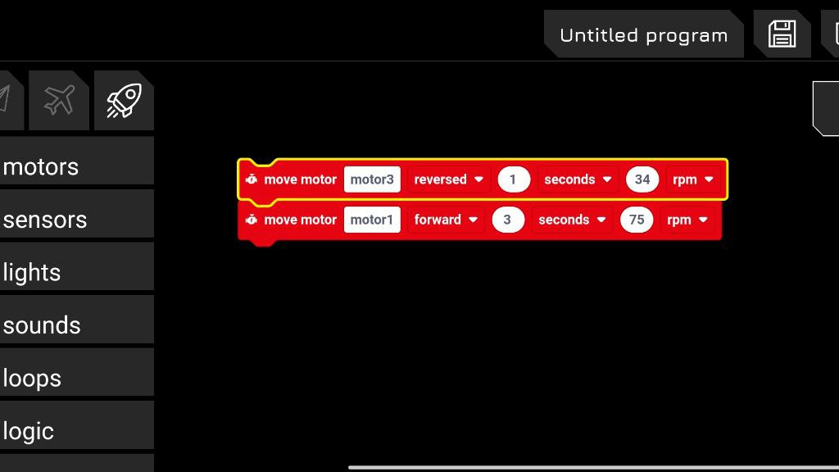
Now, we will write a code which will rise and drop the scissor mechanism.
Second motor block has been added to supply drop movement. Before testing the code, we should customize it.

Slide 19
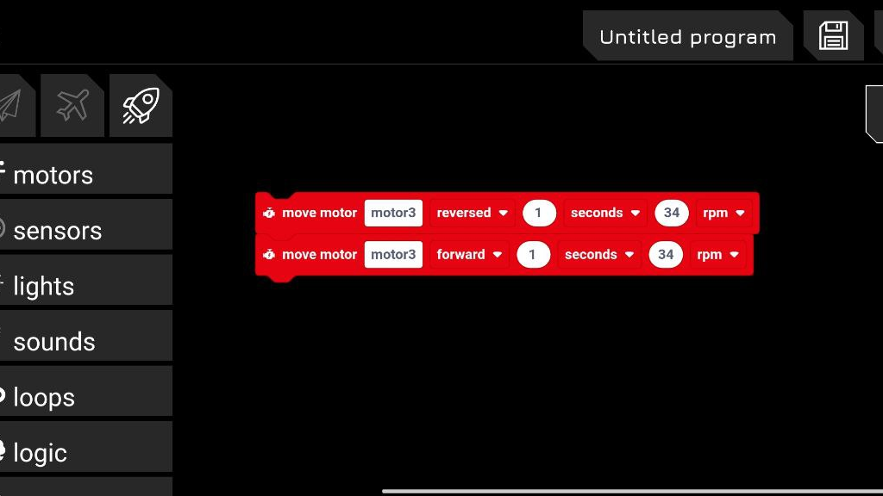
After changing important point, our code is ready for test!

Slide 20
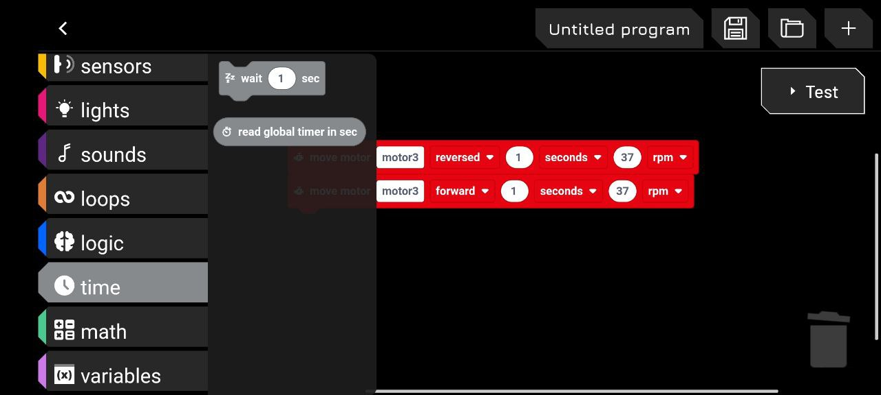
In this step, we will apply “wait” block. Main task of this block is to pause during defined time and continue.
We can find “wait” block as shown in left!

Slide 21
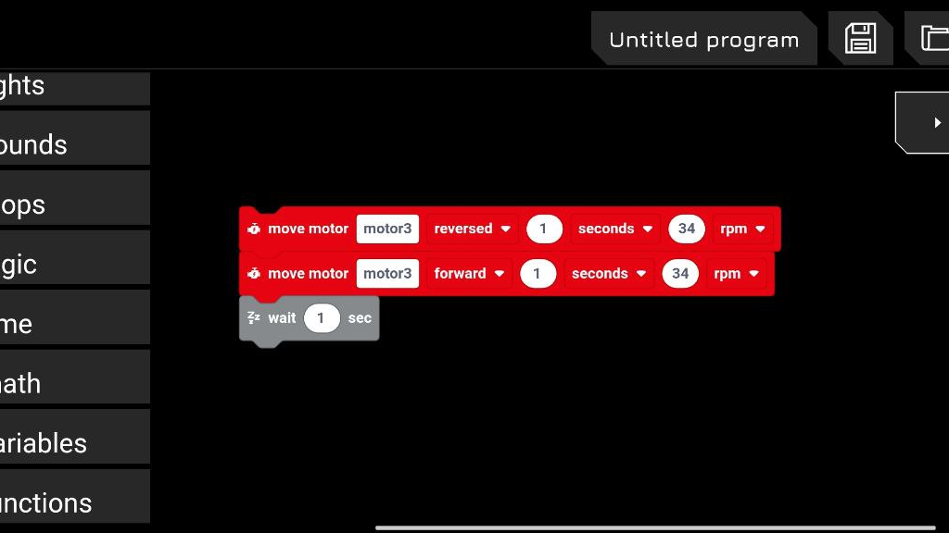
We can increase or decrease the time to pause out code.

Slide 22
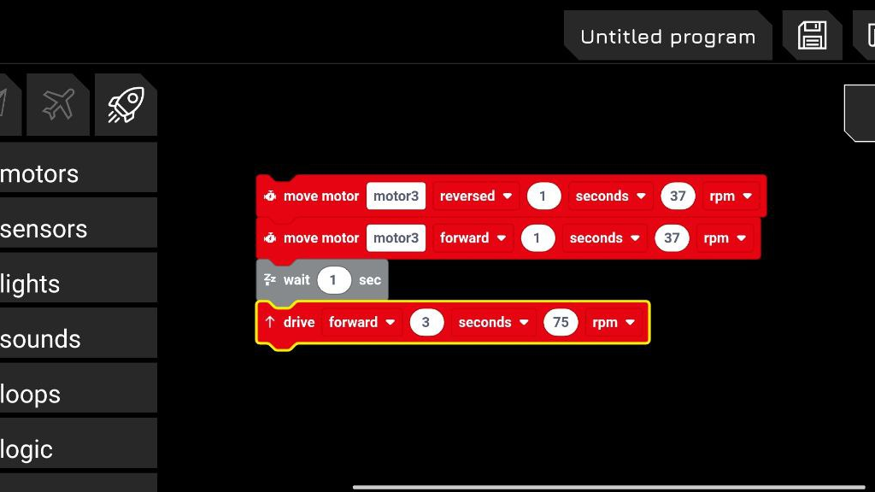
Now, we will move our robot. We have two motor for movement, and we will use drive block in order to operate two wheel connected motors.

Slide 23
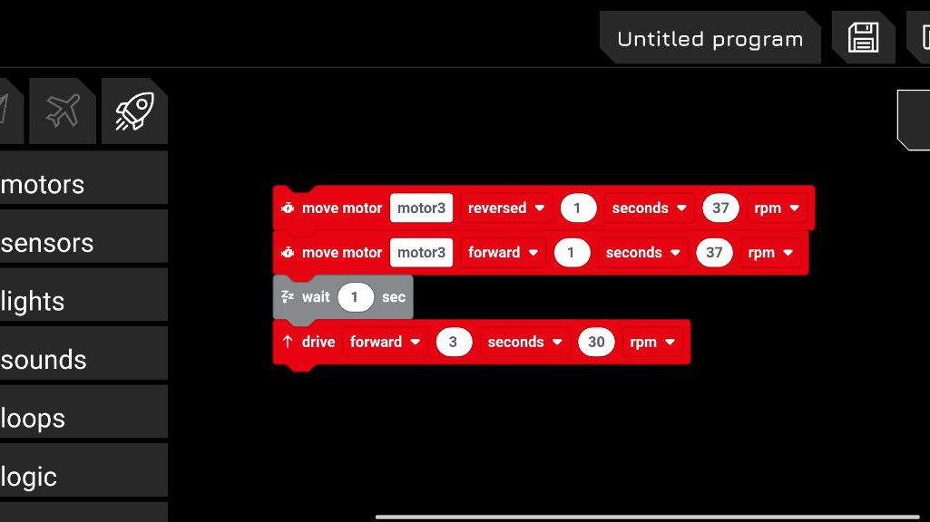
Speed also can be decreased for stable move.

Slide 24
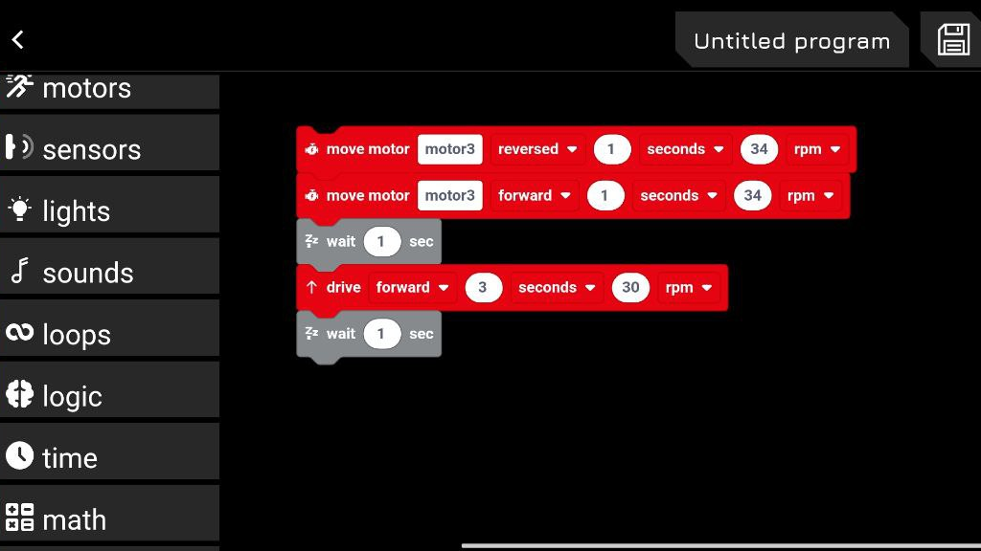
To make pause after 3 seconds forward movement, we add wait block.

Slide 25
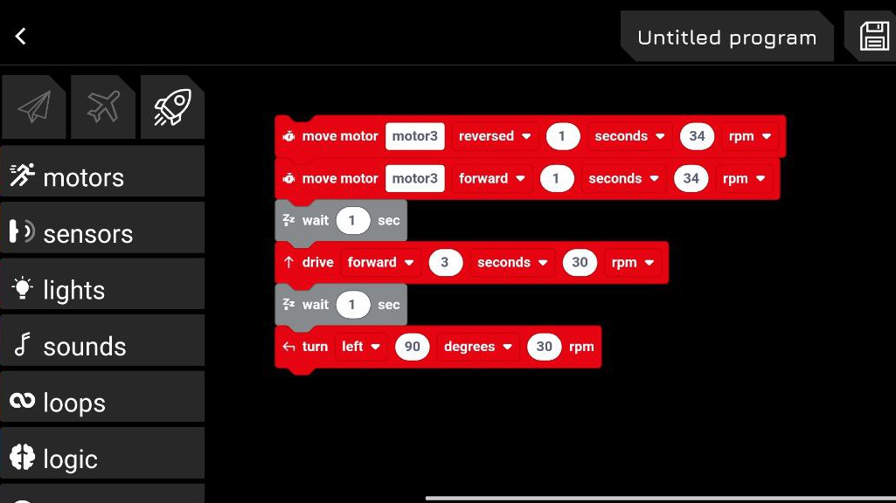
We should again decrease the speed
We can turn our robot to left with the hep of this “turn” block

